Slide 1

Crowd Funding - Kashmir

Slide 2
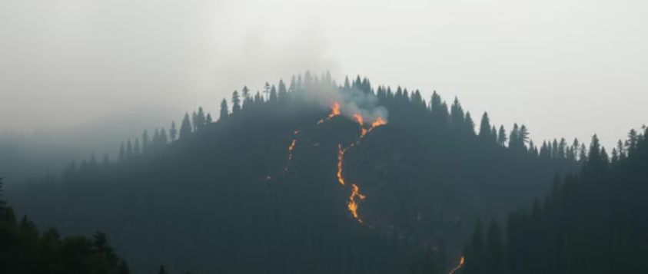
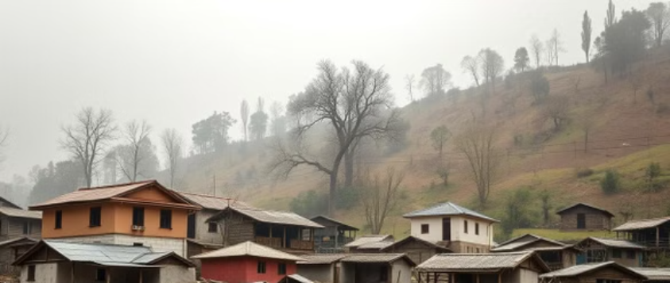
Why us?
Kashmir often faces natural disasters like fires & floods. There’s no centralized platform for reporting or tracking. Relief efforts are delayed due to lack of real-time data.

Slide 3
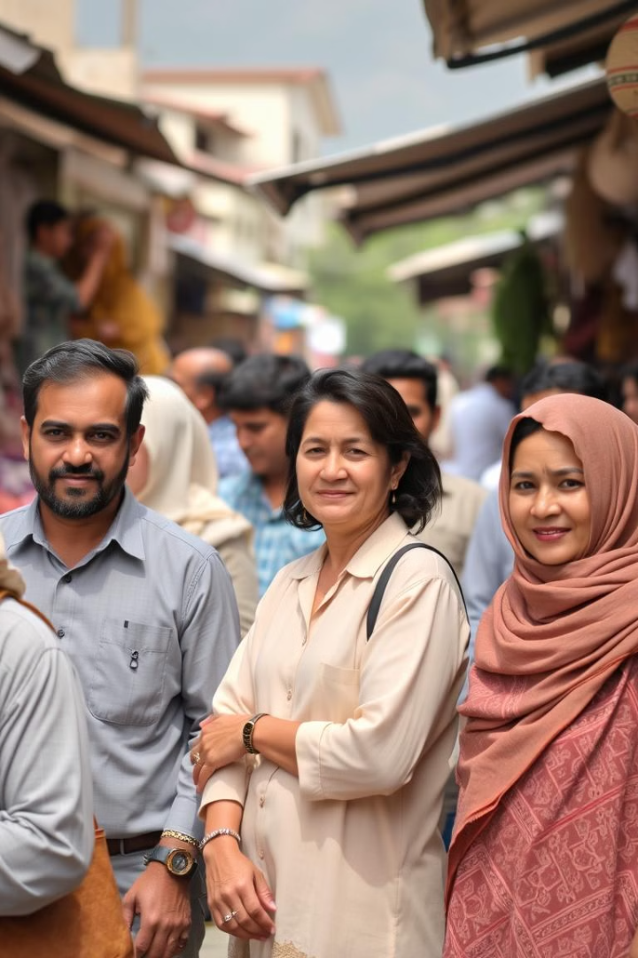
Who Is This For?
Local residents – to report disaster-hit areas.
Government & NGOs – for relief planning.
Medical teams & volunteers – to provide targeted aid.
Common public – to donate or track support centers.

Slide 4

What the App Does
Collects Info - Affected areas & available resources.
CSV File - Stores data in a lightweight, simple format.
Visualizes Data - Charts for easy understanding.
Streamlit - User-friendly and fast design.

Slide 5

Features
1
Add Entry – Report affected area, select resource type.
2
View Records – See all reported entries.
3
Visualize Data – Bar chart shows resource distribution.

Slide 6

What It Solves
Real-time Data Platform - Builds centralized system.
Bridges Gap - Connects people and help providers.
Resource Allocation - Eases aid delivery in crisis.
Community Participation - Increases citizen involvement.

Slide 7

Significance
Saves Time, Lives, Resources - Optimizes disaster response.
Empowers Citizens - Encourages participation in relief.
Expandable Design - Adaptable to other disaster types.

Slide 8


Our interaction with Ehsaas Foundation:

Slide 9

Thank You
Let’s work together to protect our people & places. Powered by Streamlit.

Slide 10


Next Steps

